Slide 1
SMART HOMES
Name:
Tutor:
Course:

Slide 2
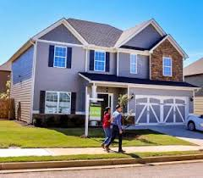
INTRODUCTION
Maslow’s hierarchy of needs theory of 1943, shelter was identified as a basic factor for human needs.
A good shelter provides security and a home for all us.

Slide 3
CONT…
It’s a place people spend a lot of time especially the elders hence the need for improving its quality.
A step to this objective is the smart home initiative.
A smart home is a system allowing the home owners to manage their lives and create a comfortable lifestyle which includes lighting features, communications, entertainment, energy management and security.

Slide 4
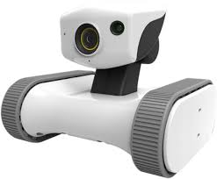
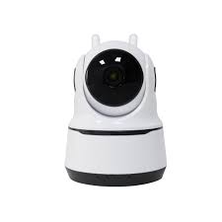
Cont…
Smart homes create a relationship between a computer and a home.
Smart homes allow getting much of security systems in the picture that includes cameras that sense movements and offers wide and clear coverage.

Slide 5
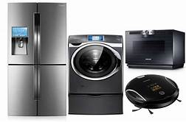
HISTORY OF SMART HOMES
The term ‘smart home’ was initially termed official back in 1984 by a group of House builders in America.
The first insight of a smart
house was in USA.
A smart house contained some
unique equipment with installed
electronics which controlled the
home. Such a home contained
appliances such as TV sets,
microwaves and washing machines.
All these appliances were made to be regulated with a single button to enable and disable them whenever.

Slide 6
CONT…
The objective of home builders was to integrate almost everything into a single network program.
The cost involved in setting such an intelligent home is very high hence very few people would afford one.
A smart home has been integrated with innovations which have enhanced more comfort and security.

Slide 7

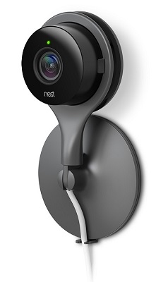

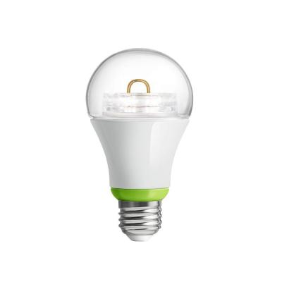
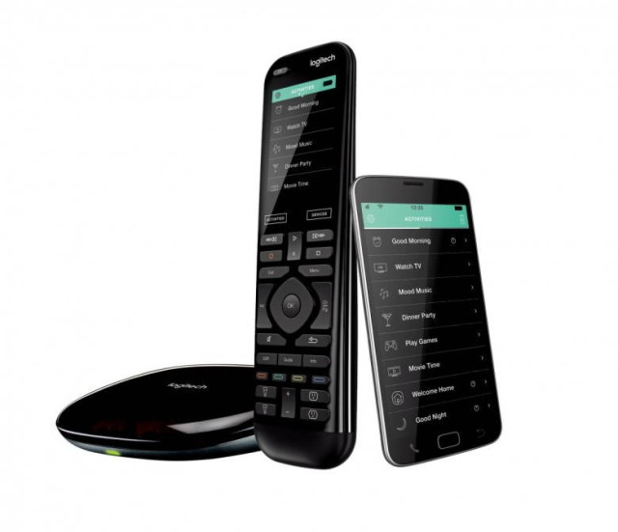
Elements of a smart home
Energy
Convenience
Security
Entertainment
Atmosphere

Slide 8
CONCEPTUAL FRAMEWORK
Muilti-fuctonality
automation
SMART HOMES
Efficiency
Interaction
Adaptabiliy

Slide 9
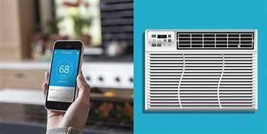
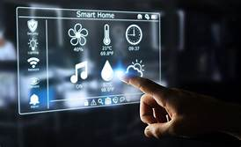
BENEFITS OF A SMART HOME
The system offers various
energy management
options which as a result
will reduce the utility
bill of a home owner with around 30% or more in a year depending with the choice of quality.
The air conditioning and the heating are automatically
regulated.

Slide 10

CONT…
The home is controlled in a menu control panel, a personal computer, smart phone or a programmed switch
People with a short term memory can benefit from a smart home for it gives updates and reminders to the home owner.
System installed can turn on and off the lights automatically in any preferred moment.

Slide 11
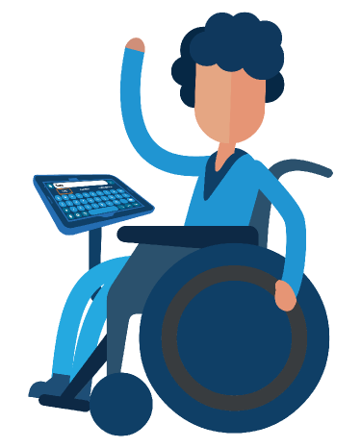
CONT…
In most homes, installing cameras is a priority to fight crimes. Most of the must have cameras are a bit costly but offers optimum security.
It suites any person
with a disability
and helps them
maintain a normal
active life.

Slide 12
CHALLENGES OF A SMART HOME
Costly
Rely mostly on internet
Technical security threats
Requires professionals

Slide 13
Evolution of a smart home
There are three stages of smart home market evolution
Stage 1: Connected standalone devices – Involves connecting most independent devices with internet to the service provider.
Stage 2: connected service silos
– Involves managing data and connection of devices vial a control hub providing a limited pint- point connection between the devices.

Slide 14
CONT…
Stage 3: integrated smart home
- Involves sharing data amongst smart home systems and devices.
Smart homes get more smart as the devices and utilities join in.

Slide 15
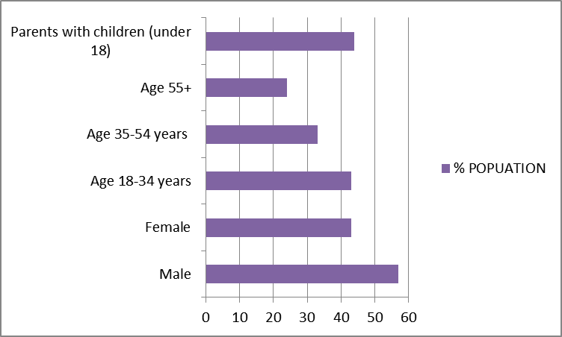
The demographic distribution of smart home technology adopters. A survey in of 4,065 adults in 2016, US

Slide 16
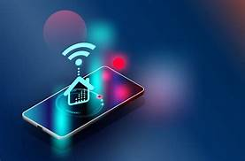

THE FUTURE OF SMART HOMES
Many people will have
adopted the smart home
market
There will be increased
connectivity of everything
in a home
Introduction of robots in
homes in human form
performing manual tasks
and managing a home.

Slide 17
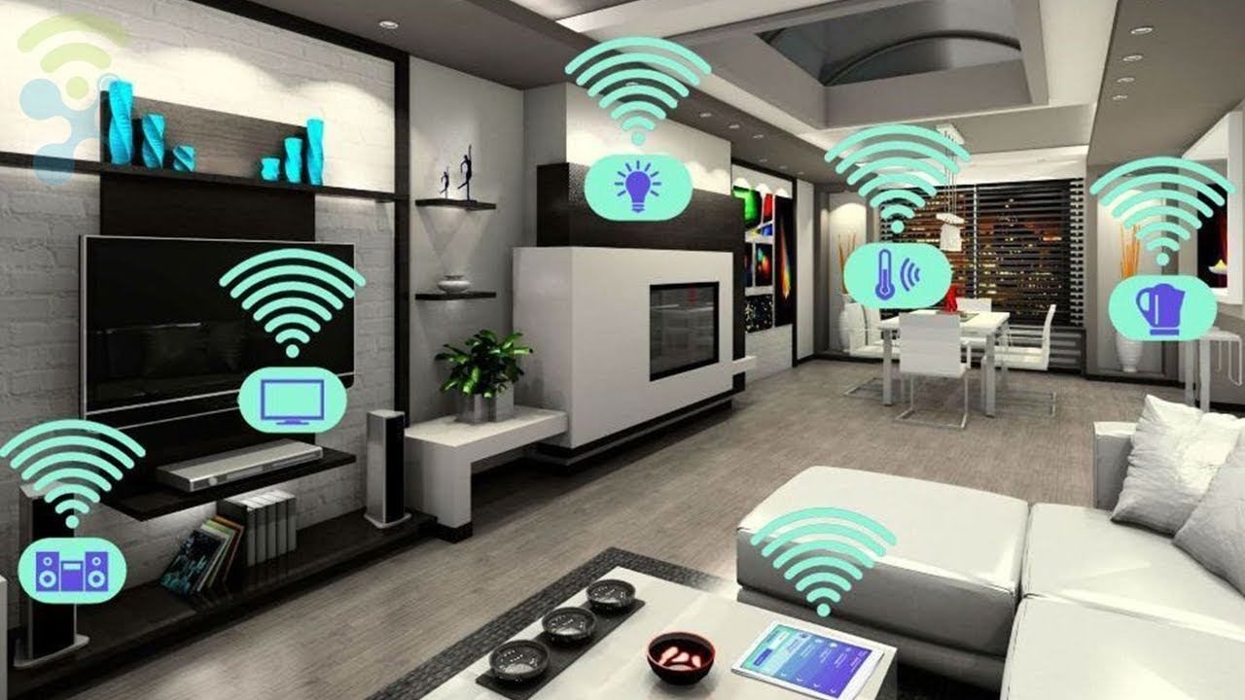
CONT..
More enhanced security and well improved lifestyle for the home owner
Internet of things

Slide 18
System features to consider
Mobile application
Standards
Personalization
Energy management
Support and monitoring
Scheduling
User friendly
Compatibility
Touch screen
Security

Slide 19

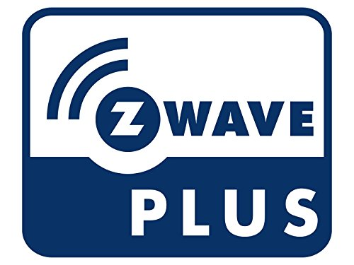


SMART HOME COMMUNICATION PROTOCOLS
Protocols is all about how signals are transferred from ne device to another to trigger an action. The protocols include;
Infrared
Ethernet
Wifi
Bluetooth
Thread
Zigbee
Z-Wave
KNX
WeMo
Nest

Slide 20
CONCLUSION
Smart home technology represents the most sectors containing internet of things
A smart home contains connection of sensors, communication, monitoring and tracking.
It should multiple technologies and systems which increases security and manage a home easily
The automation of homes today is still a peculiar concept but as technology advances and devices become smarter, most people will invest more on development of consumer products that uses internet and hence, increased competition which fuels more innovation in the field.

Slide 21
CONT…
Smart homes make life easy and better
It provides a proactive and quality life
As much as it’s expensive to set up one, it does reduce on costs especially energy consumption
Increases efficiency of performing tasks and increase security in a home
Creates ambience in a home

Slide 22
REFERENCES
Atzori, L., Iera, A., & Morabito, G. (2010). The internet of things: A survey. Computer networks, 54(15), 2787-2805.
Lytvyn, V., Vysotska, V., Shakhovska, N., Mykhailyshyn, V., Medykovskyy, M., Peleshchak, I., ... & Shcherbak, S. (2019, September). A Smart Home System Development. In International Conference on Computer Science and Information Technology (pp. 804-830). Springer, Cham.

Slide 23
CONT…
Marksteiner, S., Jiménez, V. J. E., Valiant, H., & Zeiner, H. (2017, November). An overview of wireless IoT protocol security in the smart home domain. In 2017 Internet of Things Business Models, Users, and Networks (pp. 1-8). IEEE.
Mendes, T. D., Godina, R., Rodrigues, E. M., Matias, J. C., & Catalão, J. P. (2015). Smart home communication technologies and applications: Wireless protocol assessment for home area network resources. Energies, 8(7), 7279-7311.

Slide 24
CONT…
Ricquebourg, V., Menga, D., Durand, D., Marhic, B., Delahoche, L., & Loge, C. (2006, December). The smart home concept: our immediate future. In 2006 1st IEEE international conference on e-learning in industrial electronics (pp. 23-28). IEEE.

